Slide 1
COLUMN-STORE INDEX

Slide 2
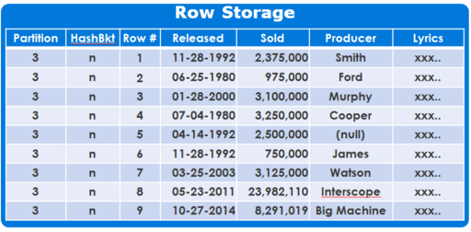
Row-Store (Traditional Relational Table)
Traditional way to store relational data
Row-store is data that is logically organized as a table with rows and columns and physically stored in a row-wise data format
More useful for traditional OLTP queries, for-example in call-centers where in you need to get the information of a customer.
Row-Store is not effective in delivering compression and performance

Slide 3
Pros and Cons of Row-Based Tables
Pros:
The application typically needs to access a complete record (or row).
Neither aggregations nor fast searching are required.
Cons:
In case of analytic applications where aggregation are used and fast search and processing is required, row-based tables are not good as it takes a lot of time.
In row based tables all data in a row has to be read even though the requirement may be to access data from a few columns.

Slide 4

ColumnStore Index: How is it different ?
Data stored as rows
Data stored as columns
C1
C2
C3
C4
C5
…
Improved compression:
Data from same domain compress better
Reduced I/O:
Fetch only columns needed
Improved Performance:
More data fits in memory
Optimized for CPU utilization

Slide 5
Columnstore Index : Terminology
Row Group
Set of rows (typically 1 million)
Column Segment
Contains values from one column from the row group
Segments are individually compressed
Data type of all the rows in a segment would be same. Hence, makes data compression easier
The data within each column’s segment matches row-by-row so that the rows can always be assembled correctly
Row Group
Column Segment
C1
C2
C3
C4
C5
C6

Slide 6
ColumnStore Index: Example
OrderDateKey | ProductKey | StoreKey | RegionKey | Quantity | SalesAmount
20101107 | 106 | 01 | 1 | 6 | 30.00
20101107 | 103 | 04 | 2 | 1 | 17.00
20101107 | 109 | 04 | 2 | 2 | 20.00
20101107 | 103 | 03 | 2 | 1 | 17.00
20101107 | 106 | 05 | 3 | 4 | 20.00
20101108 | 106 | 02 | 1 | 5 | 25.00
20101108 | 102 | 02 | 1 | 1 | 14.00
20101108 | 106 | 03 | 2 | 5 | 25.00
20101108 | 109 | 01 | 1 | 1 | 10.00
20101109 | 106 | 04 | 2 | 4 | 20.00
20101109 | 106 | 04 | 2 | 5 | 25.00
20101109 | 103 | 01 | 1 | 1 | 17.00
ROW/PAGE
compression

Slide 7
Step-1: Horizontally Partition (create Row Groups)
OrderDateKey | ProductKey | StoreKey | RegionKey | Quantity | SalesAmount
20101107 | 106 | 01 | 1 | 6 | 30.00
20101107 | 103 | 04 | 2 | 1 | 17.00
20101107 | 109 | 04 | 2 | 2 | 20.00
20101107 | 103 | 03 | 2 | 1 | 17.00
20101107 | 106 | 05 | 3 | 4 | 20.00
20101108 | 106 | 02 | 1 | 5 | 25.00
~1M rows
OrderDateKey | ProductKey | StoreKey | RegionKey | Quantity | SalesAmount
20101108 | 102 | 02 | 1 | 1 | 14.00
20101108 | 106 | 03 | 2 | 5 | 25.00
20101108 | 109 | 01 | 1 | 1 | 10.00
20101109 | 106 | 04 | 2 | 4 | 20.00
20101109 | 106 | 04 | 2 | 5 | 25.00
20101109 | 103 | 01 | 1 | 1 | 17.00

Slide 8
Step-2: Vertically Partition (create Segments)
OrderDateKey
20101107
20101107
20101107
20101107
20101107
20101108
ProductKey
106
103
109
103
106
106
StoreKey
01
04
04
03
05
02
RegionKey
1
2
2
2
3
1
Quantity
6
1
2
1
4
5
SalesAmount
30.00
17.00
20.00
17.00
20.00
25.00
OrderDateKey
20101108
20101108
20101108
20101109
20101109
20101109
ProductKey
102
106
109
106
106
103
StoreKey
02
03
01
04
04
01
RegionKey
1
2
1
2
2
1
Quantity
1
5
1
4
5
1
SalesAmount
14.00
25.00
10.00
20.00
25.00
17.00

Slide 9
Step-3: Compress Each Segment
OrderDateKey
20101107
20101107
20101107
20101107
20101107
20101108
ProductKey
106
103
109
103
106
106
StoreKey
01
04
04
03
05
02
RegionKey
1
2
2
2
3
1
Quantity
6
1
2
1
4
5
SalesAmount
30.00
17.00
20.00
17.00
20.00
25.00
OrderDateKey
20101108
20101108
20101108
20101109
20101109
20101109
ProductKey
102
106
109
106
106
103
StoreKey
02
03
01
04
04
01
RegionKey
1
2
1
2
2
1
Quantity
1
5
1
4
5
1
SalesAmount
14.00
25.00
10.00
20.00
25.00
17.00
3/23/2016
Some segments will compress more than others
11

Slide 10
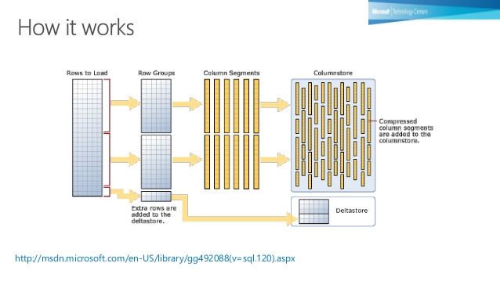
Column-Store Index
A columnstore index is a technology for storing, retrieving and managing data by using a columnar data format, called a columnstore.

Slide 11
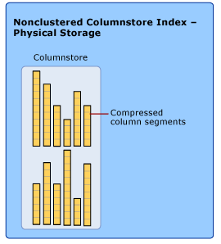
Non-Clustered column store index
A nonclustered columnstore index is a read-only index created on an existing clustered index or heap table.
Non-Clustered columnstore index is not updateable.
It contains a copy of a subset of columns, up to and including all of the columns in the table.
A nonclustered columnstore index
provides a way to have a columnstore
index for running analysis queries while
at the same time performing read-only
operations on the original table.

Slide 12
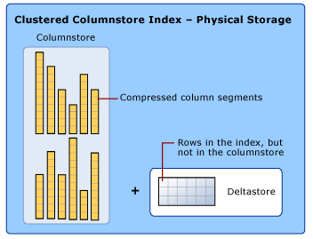
Clustered column-store index
A clustered columnstore index is the physical storage for the entire table and is the only index for the table.
The clustered index is updateable.
You can perform insert, delete, and update operations on the index and you can bulk load data into the index.
Deltastore: A deltastore is a clustered index that
improves columnstore compression and
performance by storing rows until the number of
rows reaches a threshold and are then moved
into the columnstore.
Deltastore is used with clustered column store indexes only

Slide 13
Choosing a columns for a column store index
Some of the performance benefit of a columnstore index is derived from the compression techniques that reduce the number of data pages that must be read and manipulated to process the query.
Compression works best on character or numeric columns that have large amounts of duplicated values.
Example: University name of a Student in Student table

Slide 14
Reasons for increased performance by column store indexes
1. Highly compressed data: With columnstore indexes, data from the same column is stored contiguously and will usually have repeated or similar values, which can often be compressed more effectively than in a row store. Heavily compressed data improves performance, because it requires fewer disk I/O operations. In addition, more data can fit into memory.
2. Reduced I/O: In a row store, SQL Server always reads all the columns of a row, including the columns that aren't used by the query. Columnstore uses only those columns which are required.

Slide 15
3. Batch processing: Batch execution is a query processing method in which queries process multiple rows together. Queries on columnstore indexes use batch mode execution which improves query performance typically 2-4x. Batch execution is closely integrated with, and optimized around, the columnstore storage format. Batch-mode execution is sometimes known as vector-based or vectorized execution.
4. Improved buffer pool usage: Having highly compressed data and reading only the columns that are required improves buffer pool usage, because more data can be kept in memory.

Slide 16
Pros and Cons
Pros:
Stores each column in separate set of disk pages
Hence, only need to read relevant data
Data Compression
Cons:
Inserting a row might require multiple seeks

Slide 17
Columnstore Index: TSQL Commands
Index Build:
Creates clustered columnstore index.
CREATE CLUSTERED COLUMNSTORE INDEX … // from HEAP
CREATE CLUSTERED COLUMNSTORE INDEX … WITH (DROP_EXISTING = ON) // from CI
Index Rebuild:
Re-creates clustered columnstore index completely.
ALTER TABLE … REBUILD
ALTER INDEX … REBUILD
CREATE CLUSTERED COLUMNSTORE INDEX … WITH (DROP_EXISTING = ON)

